Slide 1


InstaHyre Job Analytics
Rahul Bisht (pd16_304)
Shreya Soni (pd18_081)
Sidhartha Agasti (pd19_044)
Piyush Pratap Singh (pd19_073)

Slide 2



Problem Statement
The job market in India is constantly evolving, with new trends emerging and old ones fading away. The project aims to provide a comprehensive overview of the job market in India, using data-driven analysis to identify the key trends and patterns that are driving the market. By understanding these trends, job seekers, employers, and policymakers can make informed decisions about their career paths, hiring strategies, and workforce development initiatives. Through this project, we hope to shed light on the current state of the job market in India, as well as provide insights into how it is likely to evolve in the future. Ultimately, our goal is to help individuals and organizations make better, more informed decisions that will enable them to thrive in an ever-changing job market.

Slide 3
Objective :
Our project is to analyze the job trend in India like skill is in most demand, state having highest no of opening , & many more useful insight
Our Machine-powered system analyzes the company required skill sets and to generate recommendations like no of job opening, level of experience required, size of company which hire more & many more. This saves time and effort for the job seeker.

Slide 4
Strategy that we followed
Data Cleaning and modelling
Graphical User Interface Creation
Python : NumPy , pandas
Python : Streamlit
Web Scraping
Data Visualization and Analyses
Python : Selenium , Beautiful soup
Model Creation
Python: Sklearn , pandas, NumPy, nltk
Power bi , Excel

Slide 5
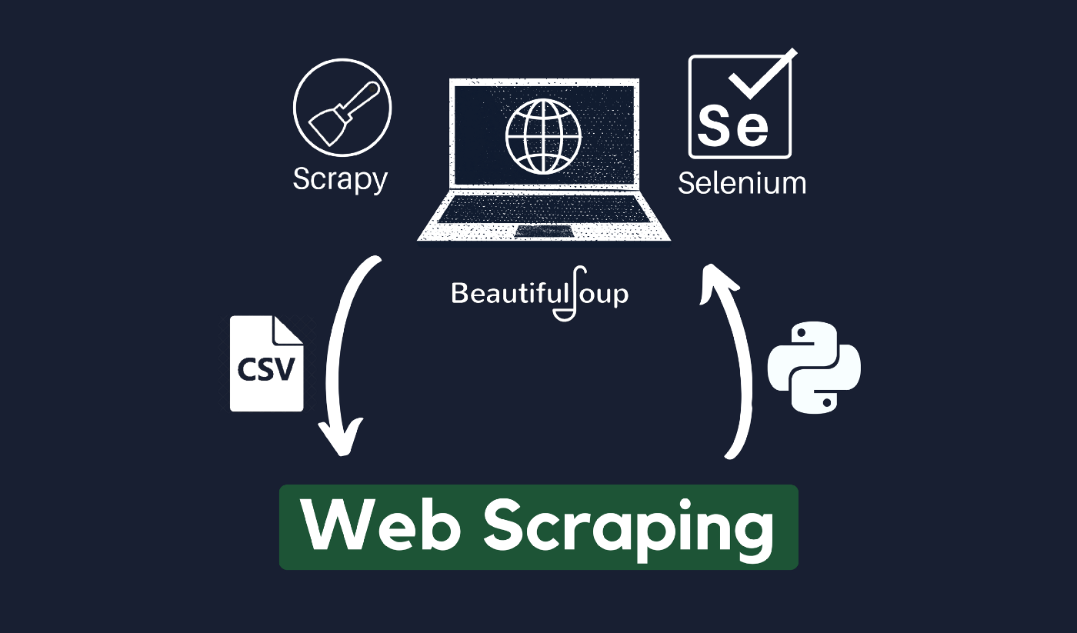



Slide 6
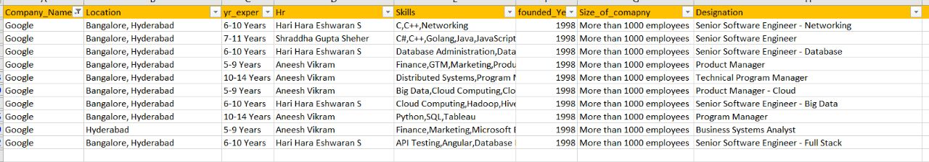
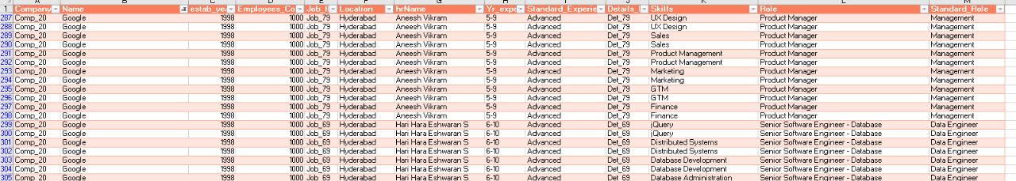
Data Pre Processing
Raw Data
Clean Data

Slide 7
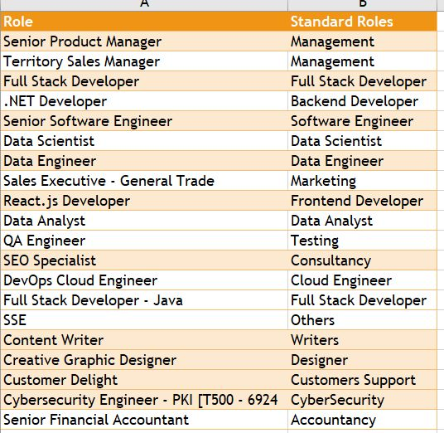
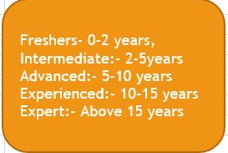
Cleaning Part

Slide 8

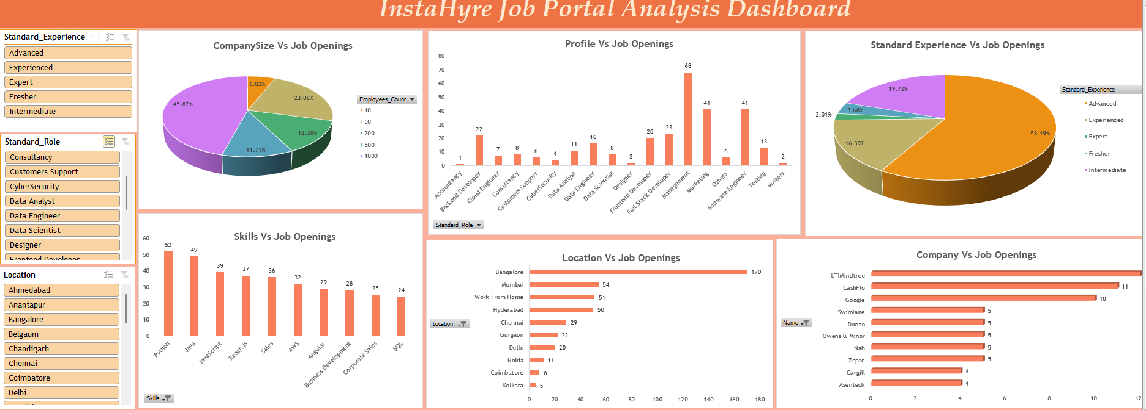
Project Insights:

Slide 9
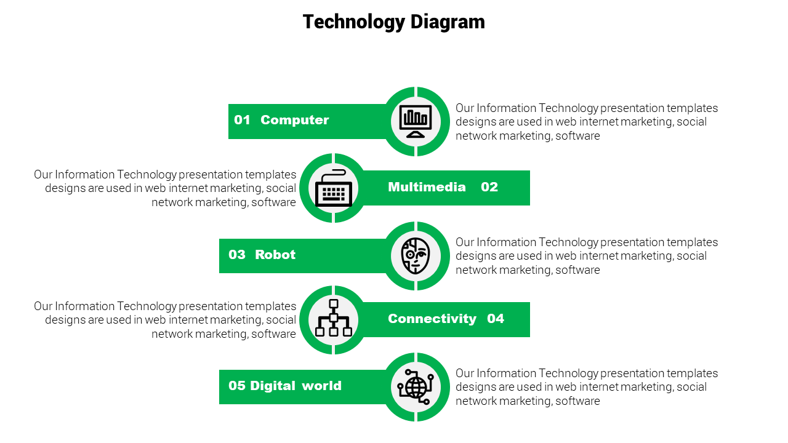
he
INSIGHTS DRAWN
From the scrapped data we have observed that Python , Java & the JavaScript are amongst the most demanded skills
01 TOP DEMANDED SKILLS
From our research and analysis we found out the that the company whose size is above 1000 employee have more opening then that of 50 employee
02 BIG COMPANY HIRE HAVE MORE OPENING
Our research and observations states that METROPOLITAN cites are leading in providing jobs opening across INDIA.
03 CITIES OFFERING MOST JOBS
LTI Mindtree , 3M & Google are the top 3 companies in terms of the number of jobs opportunities.
04 COMPANIES WITH MAXIMUM OPPORTUNITIES
From our research and analysis we found out the highest number of openings are for the CANDIDATE HAVING EXPERIENCE BETWEEN 3- 15 YEAR
05 JOB LEVEL WITH MAXIMUM OPENINGS
*all the above Insights and Observations are based only on data that we have fetched from Instahyre.

Slide 10
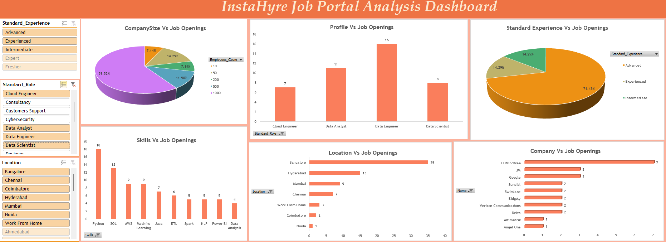
Data analyst :
Role for fresher is almost zero and company hire for this role in big in size
When company want to expand their expand the current business

Slide 11
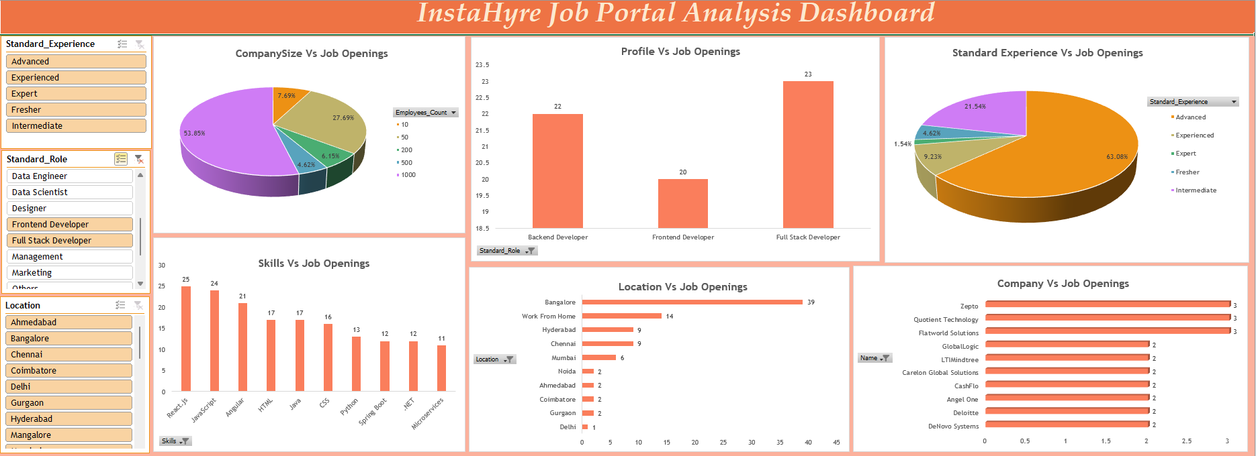
Web Developer:
job opening for all most all type of person and all company hiring either MNC or Startup
Reason : company need at least a website for represent what they are doing
The demand for the web developer is quite high in every segment of company either is small or big but the demand for data role is only in the big company

Slide 12
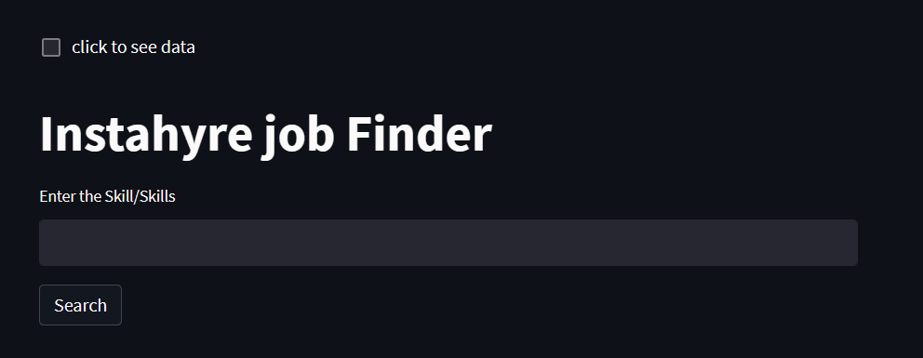
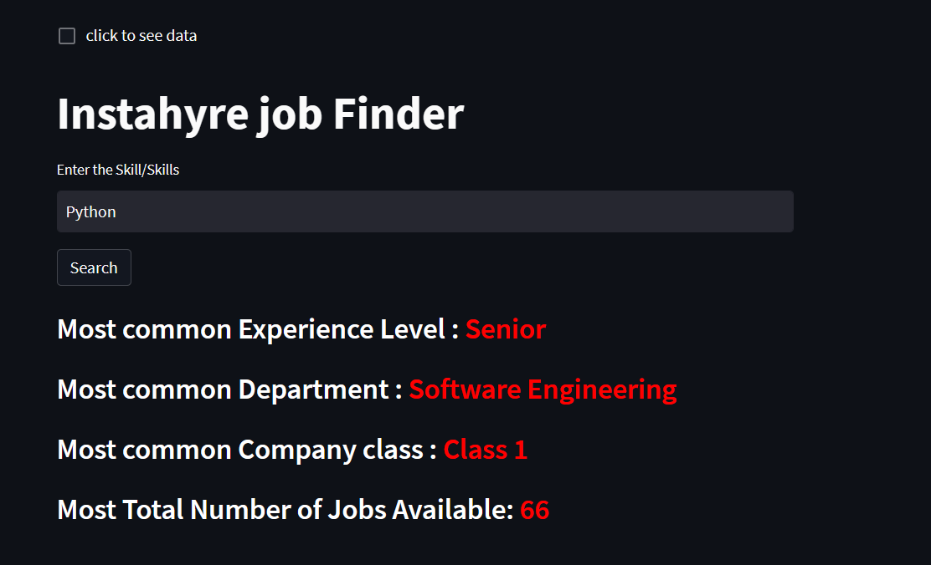
Machine Learning Model Graphical Interface
Revolutionizing the Job Search:
A Machine Powered System for Career
Recommendations Based on Skill Set

Slide 13
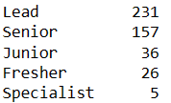
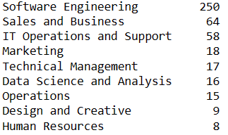
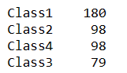
About the Model
1
Most common Experience Level
Model : RandomForestClassifier
Accuracy Score : 57%
2
Most common Department
Model : RandomForestClassifier
Accuracy Score : 88%
3
Most common Company class
Model : Logistic Regression
Accuracy Score : 60%

Slide 14

Problem Encounter
Non-technical | Technical
Coordination issue: Not discuss about the problem in the starting directly jump into the technical part | Model Building Issue: Need to learn how to deal with the text data Explore the NLTK Library
Time issue: Some of us are working some of them are not, not all of them are free at the same time | Model Deployment Issue: Get to know about the different ways to deploy the model Explore about the streamlit library

Slide 15
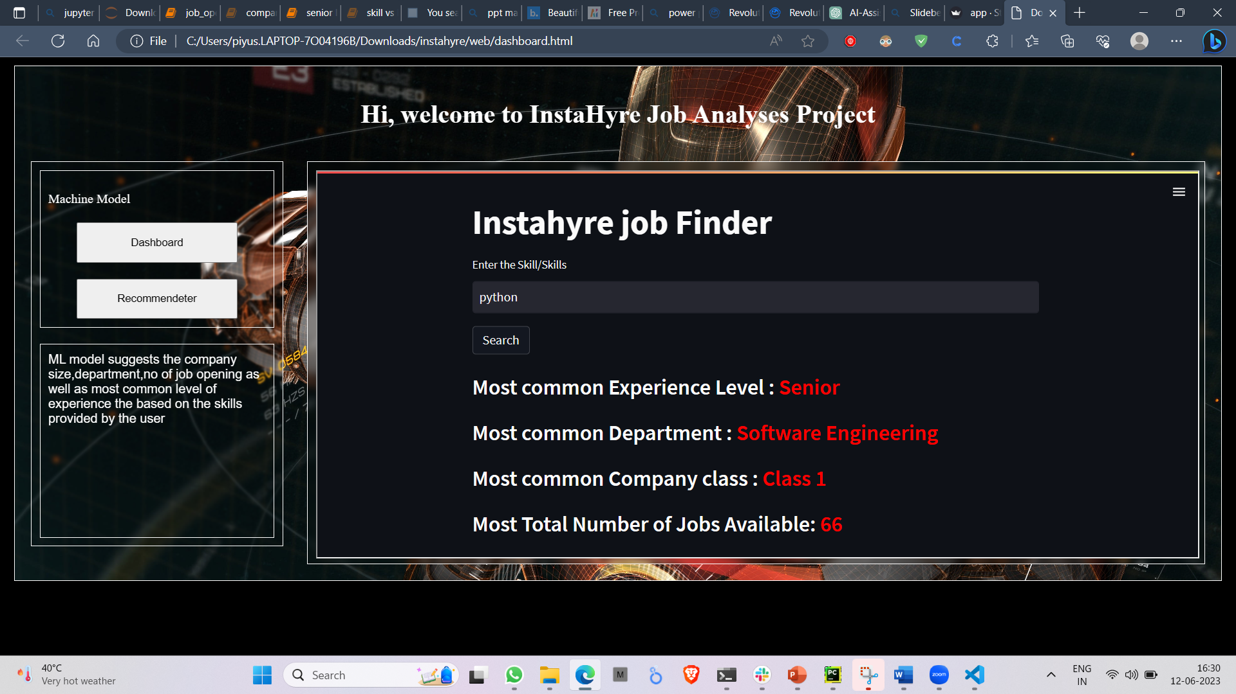
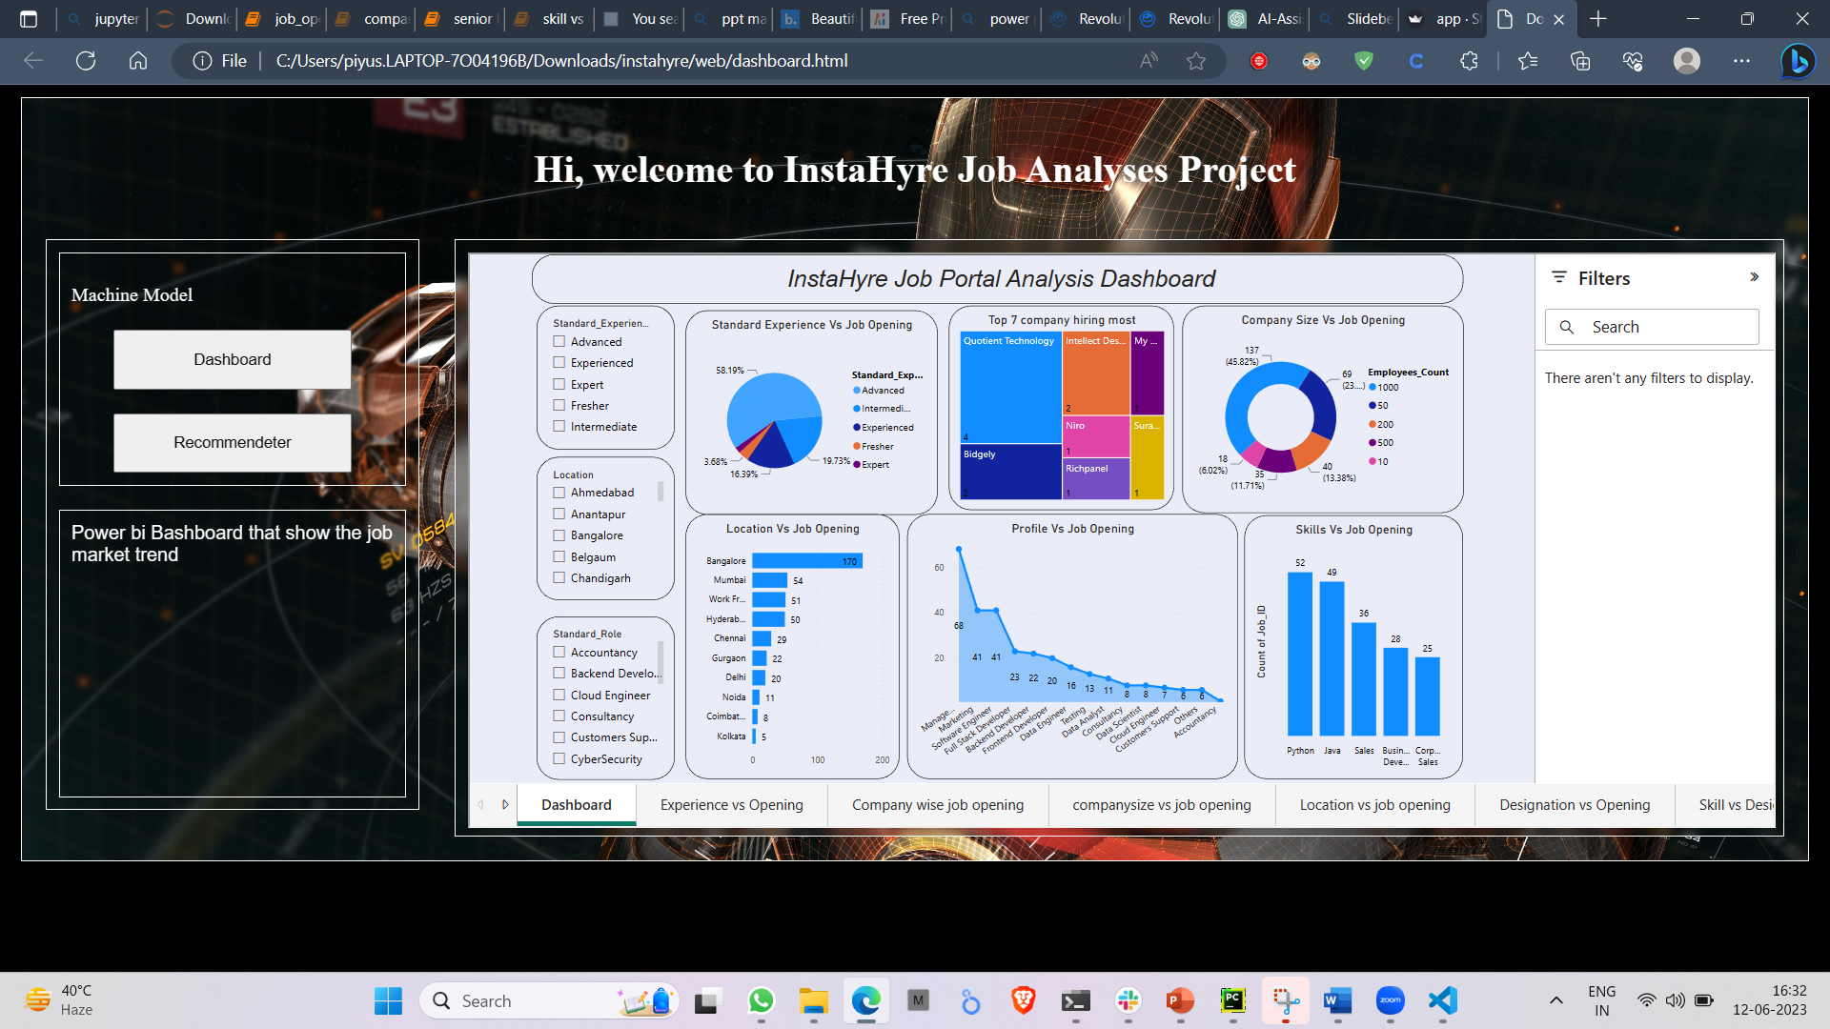
Future Scope
Increase the Accuracy Level
Deploy it into the web server
Enhance the GUI

Slide 16


Learning Outcome
Collaboration and teamwork
Project management
Diversity and inclusivity:
Learn new tools
Presentation and communication skills

Slide 17



Conclusion
Working
Our system uses machine learning algorithms to analyze job postings. It then matches skills enter by the user with their training dataset and recommended the no of job opening , level of experience , company class and many more to user
Benefits
Our system saves job seekers time and effort by providing recommendations that match their skill sets and experience. This ensures that job seekers are applying to relevant job postings, increasing their chances of finding the right job.
Drawback
Have the limit data and data is static is nature

Slide 18




Thank you

